Slide 1
UNIX

Slide 2
Course Objective
To discuss about the basics of UNIX OS
• To describe the various commands of UNIX

Slide 3
Session Objective
Unix Introduction
Unix Architecture
Kernel
Shell
Unix directory commands
Pipes & Filters
Vi Editor

Slide 4
Learning material references
HexaGuru+
– Unix Command and Shell Scripting
Books
– Unix concept and Application by SumitaBha Das 4th Edition
Web
– http://hexaware.skillport.com/skillportfe/main.action – http://www.tutorialspoint.com/unix/

Slide 5

UNIX - Introduction
UNIX is an operating system which was first developed in the 1960s
It is a stable, multi-user, multi-tasking system for servers, desktops and laptops.
The most popular varieties of UNIX are Sun Solaris, GNU/Linux, and MacOS X.

Slide 6
UNIX ARCHITECTURE

Slide 7
Unix Architecture Cont…
UNIX has a layered architecture with two major separable parts
- Kernel
-Systems programs
Components of the UNIX OS are
-Kernel
-Shell
-Command and Utilities
-Applications

Slide 8
Kernel Cont…
Kernel forms the heart of the UNIX OS
Kernel provides various types of services to the users
In the bootstrapping process, the kernel is loaded into the memory and initiates various other processes for the users to effectively make use of the Unix OS.

Slide 9
Shell Cont…
Shell acts as an interface between the user and the UNIX OS
It is called the “Command interpreter”.
Every user of the UNIX OS is provided with a shell by the kernel.
Kernel controls all the functions of the OS whereas Shell provides services to different users of the OS
Shell acts as “command interpreter” which gives different types of prompts for different types of shells like %, $ etc.

Slide 10
UNIX Commands: Directory

Slide 11
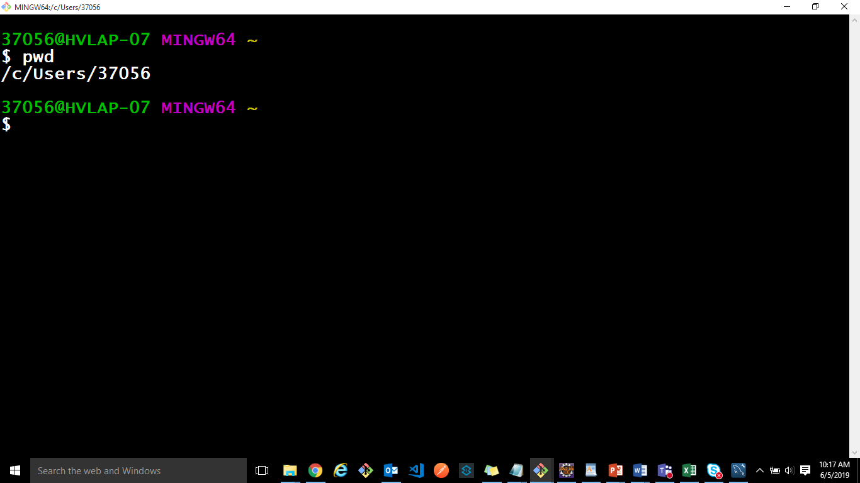
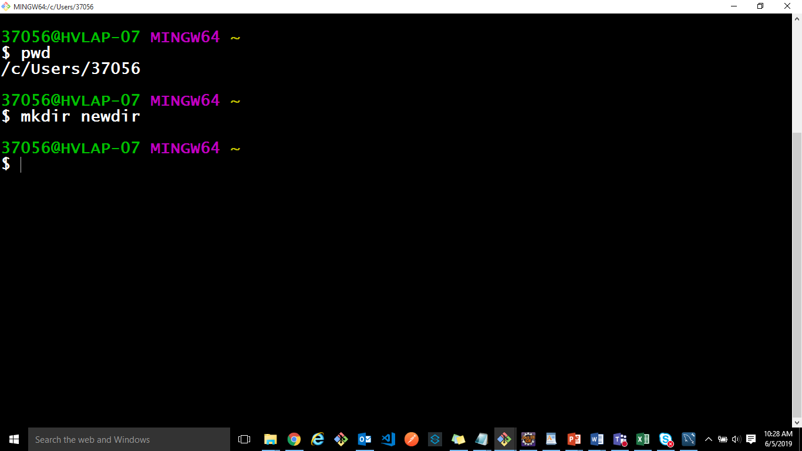
Directory Command
pwd
To get the present working directory
pwd is used to identify the present directory in which the user is working.
$ pwd <enter>
mkdir
To create a new directory by an user in Unix
$mkdir dirxyz

Slide 12
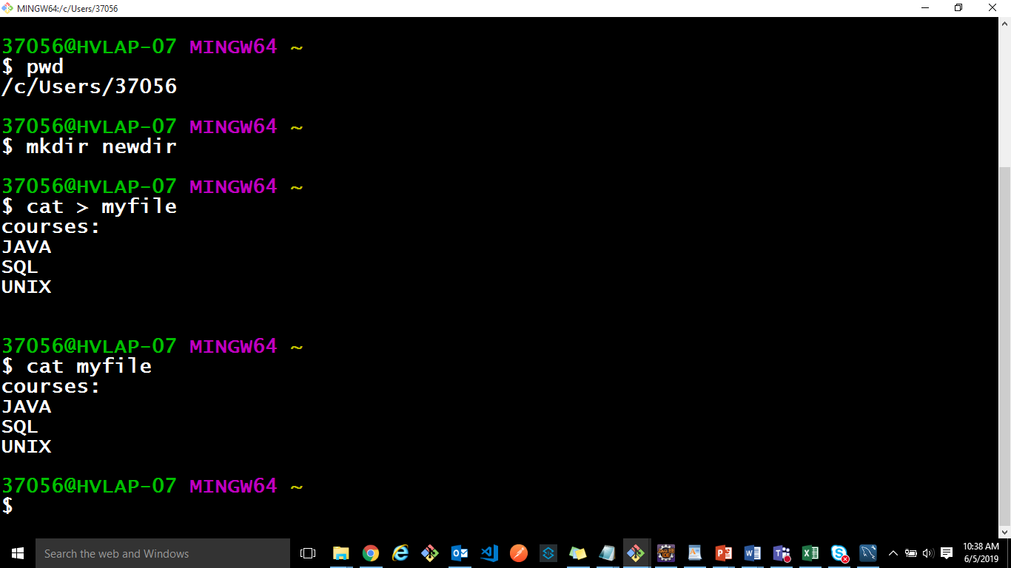
Directory Command Cont…
cat
$ cat > file
It creates a new file by accepting text from the standard input

Slide 13
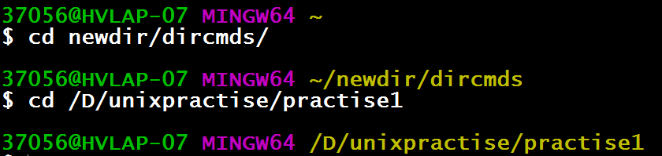
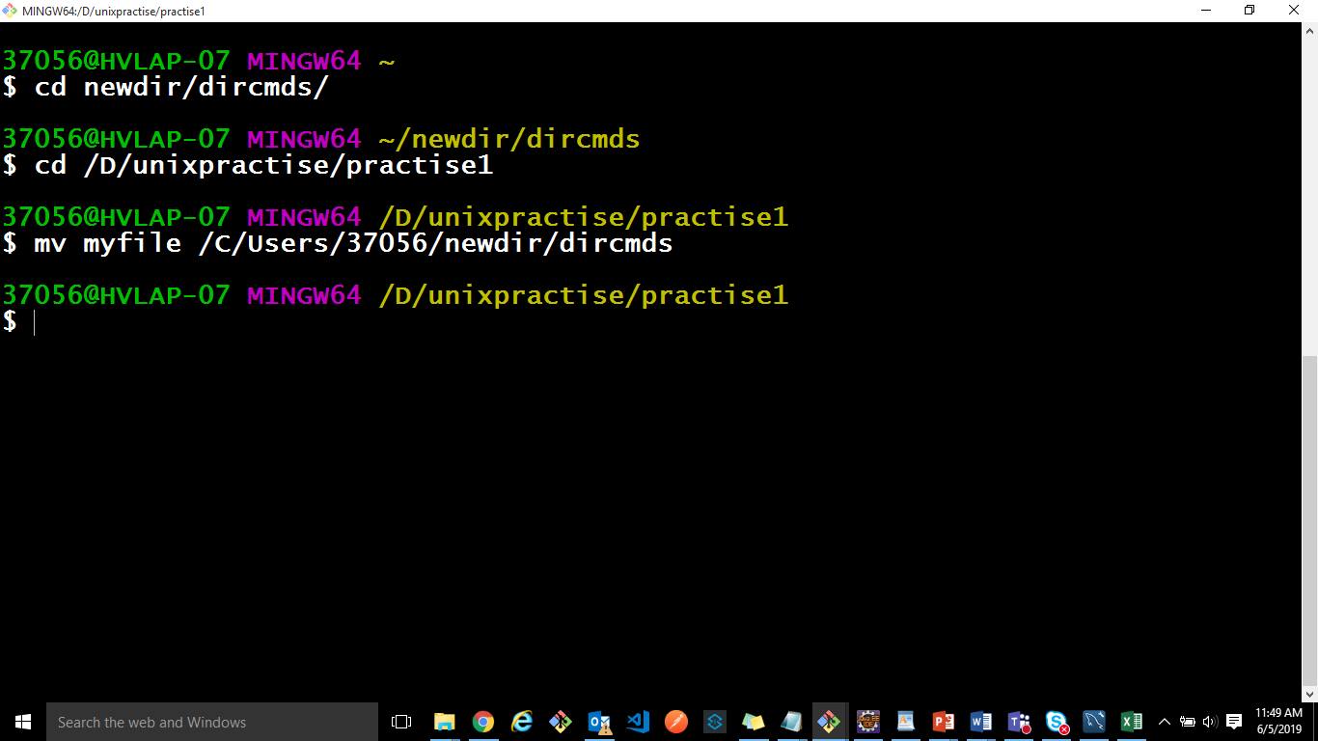
Directory Command Cont…
cd
To change from the present working directory
Changing from one directory to the other is done by the command cd
$cd /usr/dirxyz/AP
mv
To rename the files
mv is used to change the name of files and directories
$mv fileabc filexyz

Slide 14
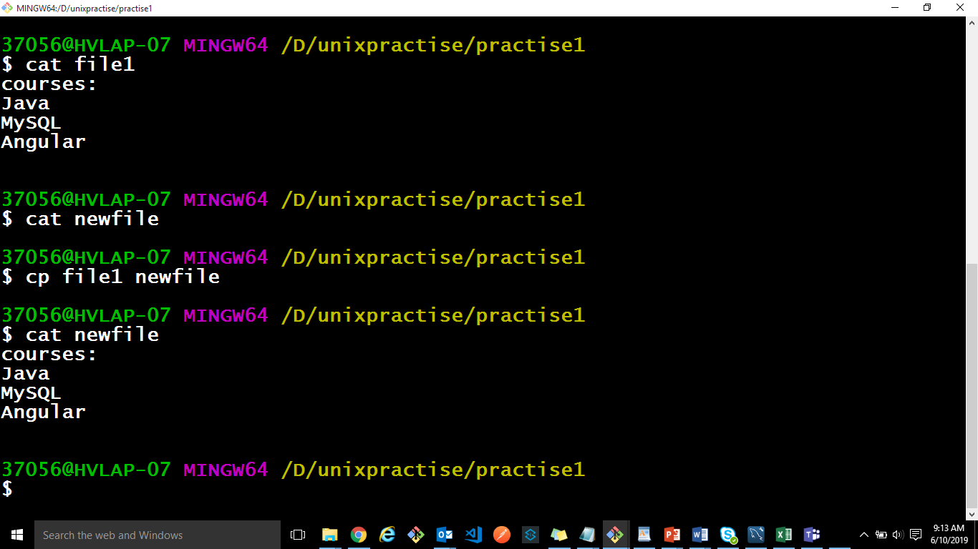
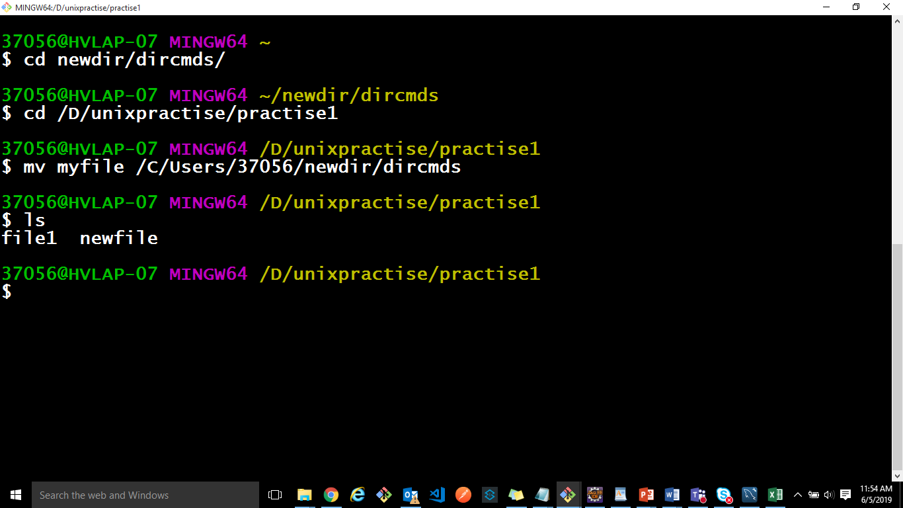
Directory Command Cont…
cp
To copy the contents of one file into another file
$ cp file1 file2
Copies file1 to file2
ls
The command ls is used to list the files and directories which are available in that current working directory
$ ls <enter>

Slide 15
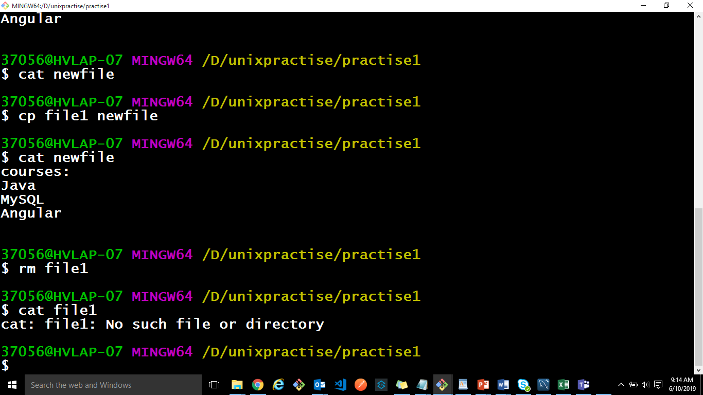
Directory Command
rm
To delete a file
rm command is used for deleting unwanted files/directories
$ rm file
rmdir
To remove a directory from the file system
$rmdir dirxyz

Slide 16
Practice Exercises
1. Change the current directory to /user/hvuser/workspace.
2. Create new directory called MVP.
3. Create the file trainees.txt in the MVP and add some trainees name.
3. Display content of file trainees.txt
4. Rename the file from trainees to maverick.txt.
5. Write a command to listing of file details such as data, size and access permission.

Slide 17
Pipes & Filters

Slide 18
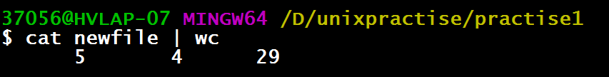
Pipes
It is a feature by which filters & other commands can be combined in such a way that the standard output of one filter or command can be sent as standard input to another filter.
e.g. $ cat newfile | wc
Pipe
Input
Output
Newfile | wc

Slide 19
Filters Cont…
A filter is a shell command which takes input from the standard input, processes it, and sends its output to the standard output (unless we redirect the input and output)
• At run time, the system supplies data to the filter as standard input. This standard input file can not be altered by the program.

Slide 20
Filters Cont…
Command | Function
cut | A given number of columns will be shown in the standard output
comm | Line by line comparison of two files
paste | Horizontally to combine two files
diff | To get the different between two files
grep | Globally search for the regular expression and print it
tail | To output only required number of lines
uniq | Used to count / eliminate repeated (duplicate) lines in a file which is pre-sorted
head | To show the first few lines of the file
cmp | To compare two files

Slide 21
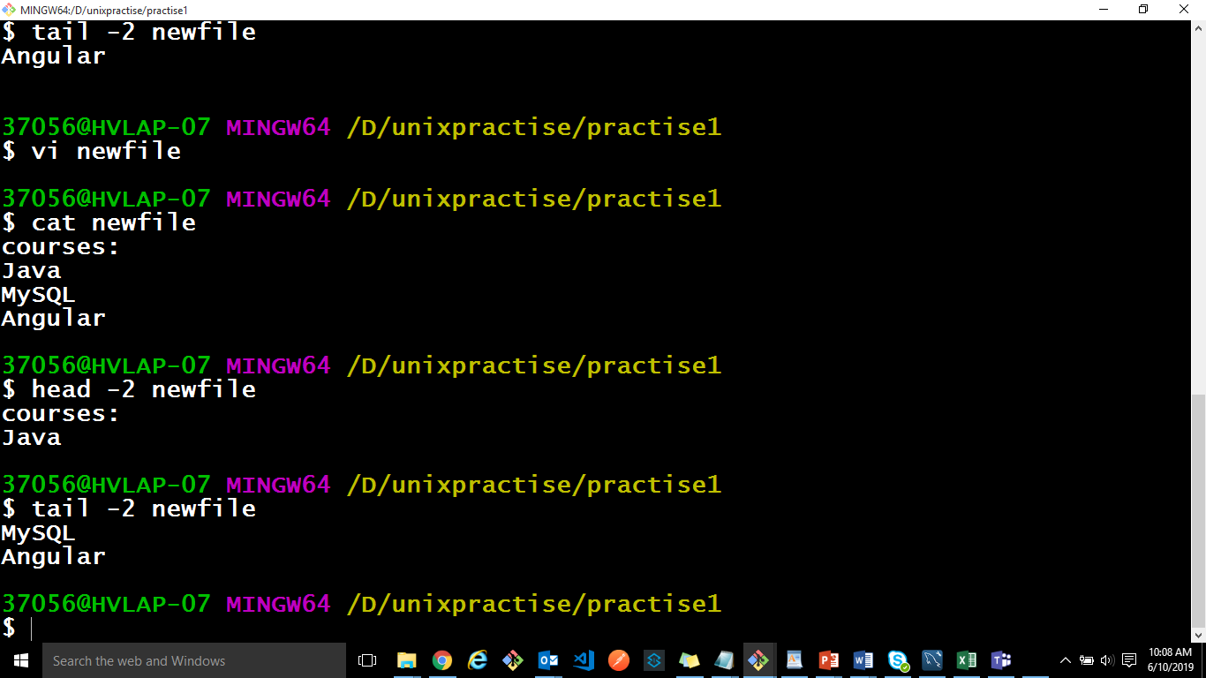
Filters Cont…
• head:
- displays first ‘n’ lines, horizontal slicing
- $ head -[n] [filename]
• tail:
- displays last ‘n’ lines, horizontal slicing
- $ tail -[n] [filename]

Slide 22
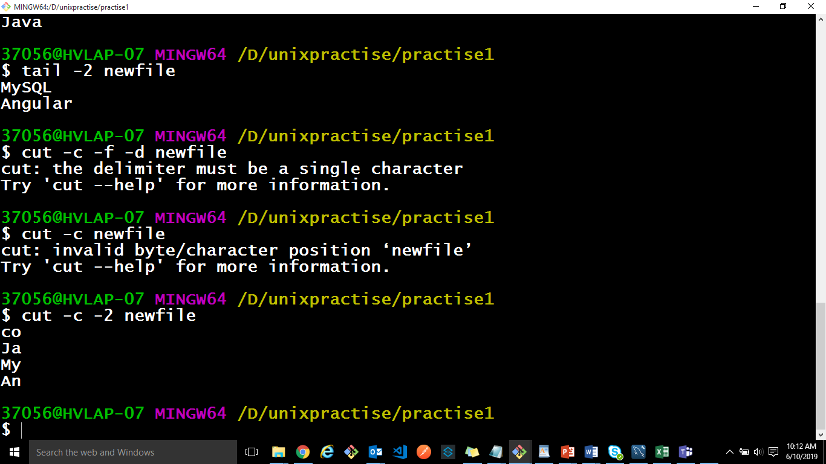
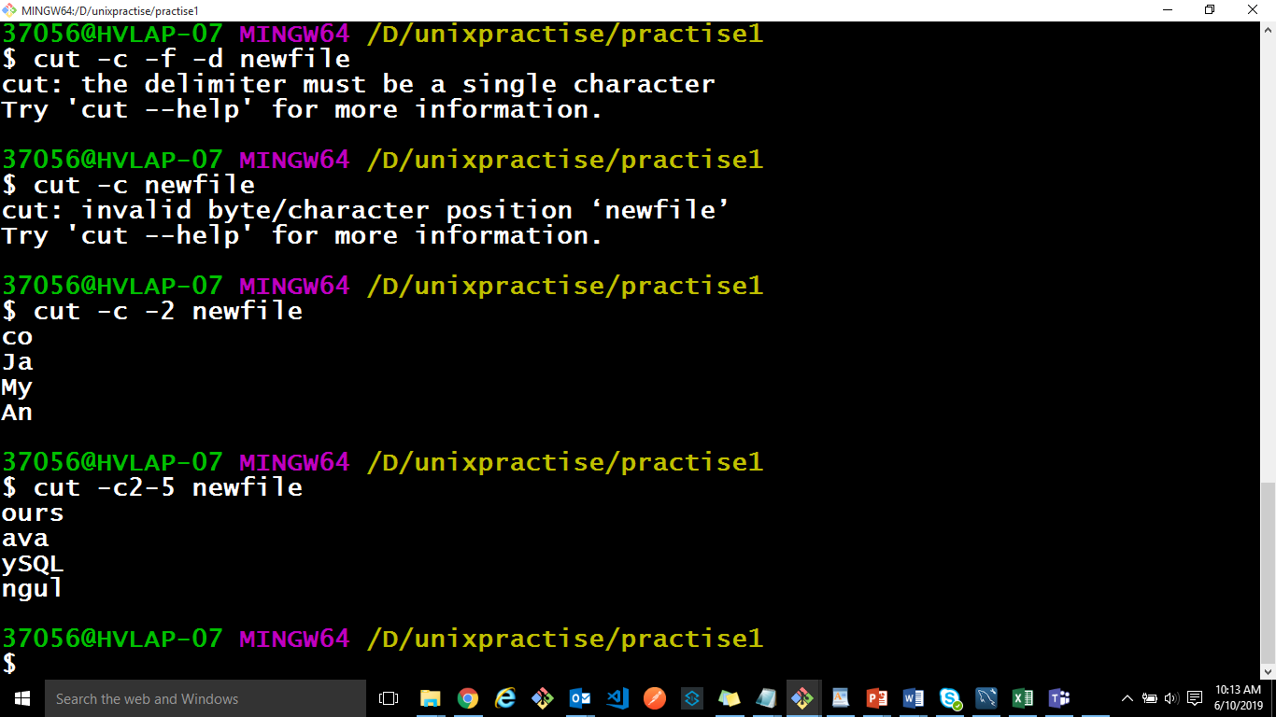
Filters Cont…
cut:
- cuts file vertically either column wise/field wise
• $ cut -[cfd] [filename]
– -c columns/characters
– -f field number
– -d field delimiter/separator
$ cut -c2-5 sample
– cuts columns 2 to 5 from the file sample

Slide 23
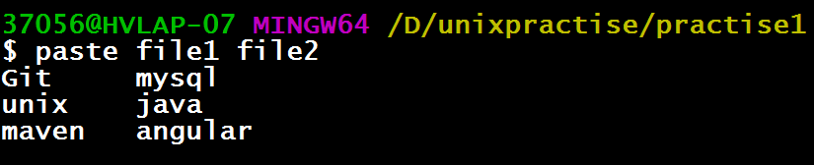
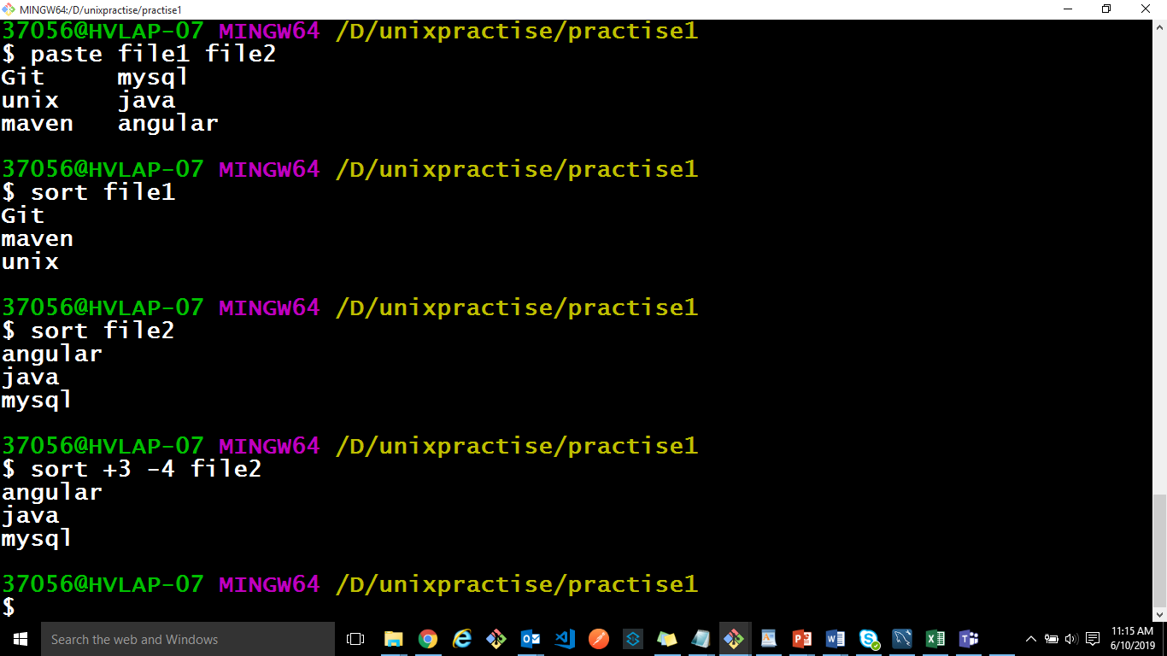
Filters Cont…
paste:
- merges lines of specified files and display onto standard output
- $ paste -d[field separator] [list of files]
• sort: ordering text files
- $ sort filename

Slide 24
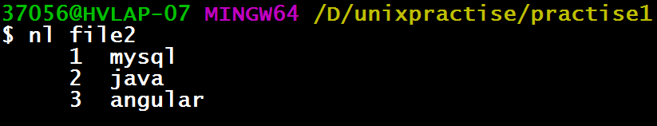
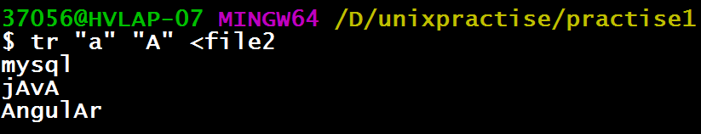
Filters Cont…
• nl: number lines of files
– $ nl –[options] [files]
tr:translating Characters
$ tr [options] < [file]
-d: deletes specified characters
-cd: do not delete specified characters
-s: substitute multiple occurrences of a character by single occurrence.
• $ tr “abc” “ABC” < samp: replaces all occurrences of a with A, b with B, c with C

Slide 25
Practice Exercises
1. Write the command to sort the maverick.txt file and print the uniq values.
2. Use head and tail to print the lines in a particular range in a file.
3. Write the command to extract two columns from the file.
4. Write the command to count lines, words and characters in a file.
5. Display the first 5 lines of the file “maverick.txt" on the screen.

Slide 26
Vi Editor

Slide 27
Vi Editor Cont…
The vi editor is a screen-based editor which lets a user create new files or edit existing files
A key concept in vi is combining a certain action with a movement
vi is extremely powerful in moving around within (or between) files

Slide 28
Vi Editor Cont…
vi session begins by invoking the command “vi” with a filename
$ vi [filename]
• vi can be started without a filename, and it can be saved when required.
• The last line in the screen is reserved for some commands that can be entered to act on the text. This line is also used by the system to display messages.

Slide 29
Vi Editor Cont…
The three different modes of operations are:
– Command mode:
This is the default mode where commands are passed to act on the text, using most of the keys of the keyboard
Switch to this mode using “Esc” key
– Insert (Input) mode:
To enter the text, go to input mode
Press key “i” to enter into insert mode from command mode
Switch to command mode by pressing “Esc” key

Slide 30
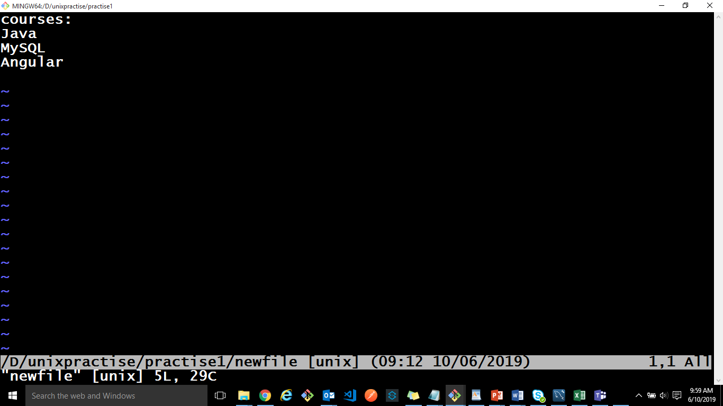
Vi Editor Cont…
ex mode or line mode:
Save the file or switch to another file or make a global substitution in the file.
Use ex mode, where instruction can be entered in the last line of the screen.
To enter into this mode, press “Esc” key followed by “:”

Slide 31
Vi Editor - Commands Cont…
i inserts text before cursor position
a Appends text after cursor position
I inserts text at beginning of line
A Appends text after end of line
o opens line below current line to insert text
O opens line above current line to insert text

Slide 32
Practice Exercises
Copy the file "foo.txt" into "foo.txt.copy".
Rename the file "foo.txt.copy" to "foo2".
Move the file "foo2" into the "data" subdirectory.
Create a new subdirectory called "new" in the unix directory.
Move the file "foo2" in the "data" directory into the "new" directory.
Move the file "foo2" in the "new" directory back into the "unix" directory and change the name to "foo.old".
Delete the file "foo.old".
Remove the "new" subdirectory.

Slide 33
Summary
UNIX is a stable, multi-user, multi-tasking system
Kernel provides various types of services to the users
Shell acts as an interface between the user and the UNIX OS
A directory contains some fields like the file name, a pointer which is directed to a disk space which has details regarding the files which are stored
Pipes and filters are featured by which filters & other commands can be combined in such a way that the standard output of one filter or command can be sent as standard input to another filter
The vi editor is a screen-based editor which lets a user create new files or edit existing files

